Slide 1

Jca restore our family minggu 1
HARI KAMIS

Slide 2

ANYAMAN
http://indicafisha.blogspot.com/2017/08/cara-membuat-kerajinan-hias-anyaman.html

Slide 3
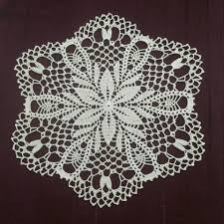
TAPLAK RAJUTAN
https://www.facebook.com/pg/yvonnesumilat/posts/

Slide 4
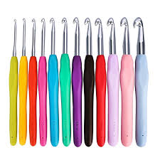
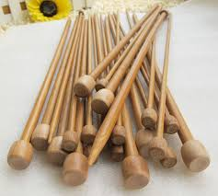
ALAT RAJUT
https://www.tokopedia.com/gitagalerirajut/jarum-rajut-alat-rajut-set-gagang-karet
https://www.mayacrafts.asia/shop/benang-rajut-poly-d27/

Slide 5
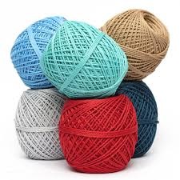
BENANG RAJUT
https://www.mayacrafts.asia/shop/benang-rajut-poly-d27/

Slide 6
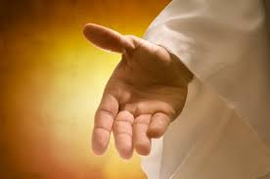
MAZMUR 139:13 Engkaulah ( Engkau sendirilah)
Mazmur 139:14 Kau buat ( Handmade, Tenunan)
https://renunganindah.wordpress.com/tag/tangan-tuhan/

Slide 7
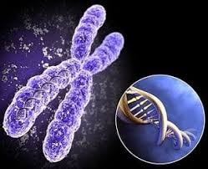
KROMOSOM MANUSIA
https://www.dosenpendidikan.co.id/struktur-kromosom/

Slide 8
TAMBAHAN PENJELASAN

Slide 9
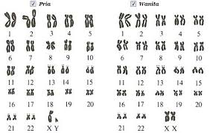
https://materibelajar.co.id/kromosom-manusia/

